Slide 1
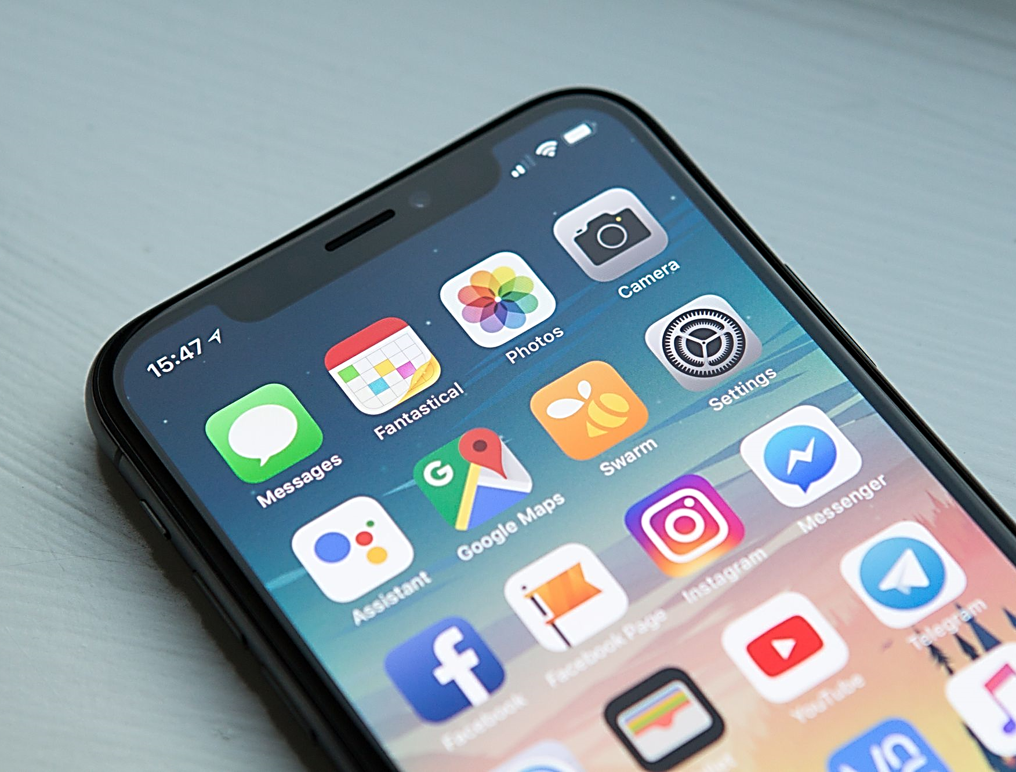


Mobile Apps Programming
P E D Putra, M.Si.
Lecture 2 – Software Development Kits (SDK): Types, How to install

Slide 2

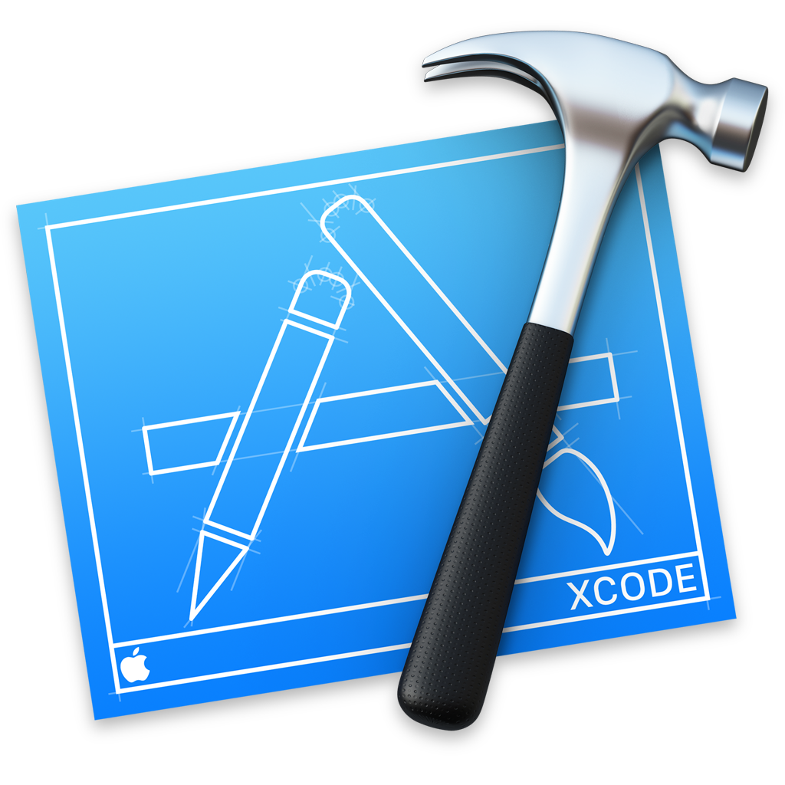



Software Development Kits (SDK)
Software Development Kits (SDKs) are essential tools that allow developers to create apps for specific mobile platforms.
Traditional SDKs
Cross-platform SDKs
An open-source Python library and framework for developing cross-platform mobile applications, including Android, iOS, Windows, Linux, and macOS
Kivy

Slide 3
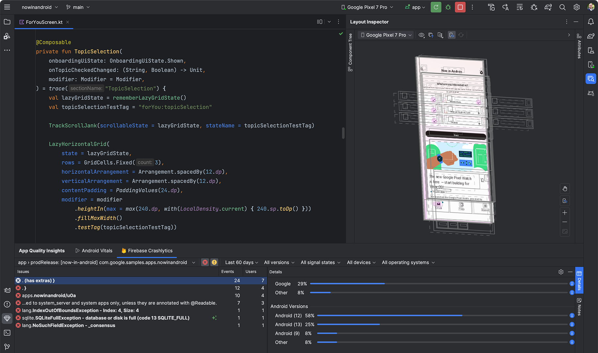
Androids Software Development Kits (SDK)
Android SDK is a collection of software tools, libraries, and resources provided by Google for developers to create Android applications.
Androids Studio
The official Integrated Development Environment (IDE) for Android app development.
Download
https://developer.android.com/studio

Slide 4
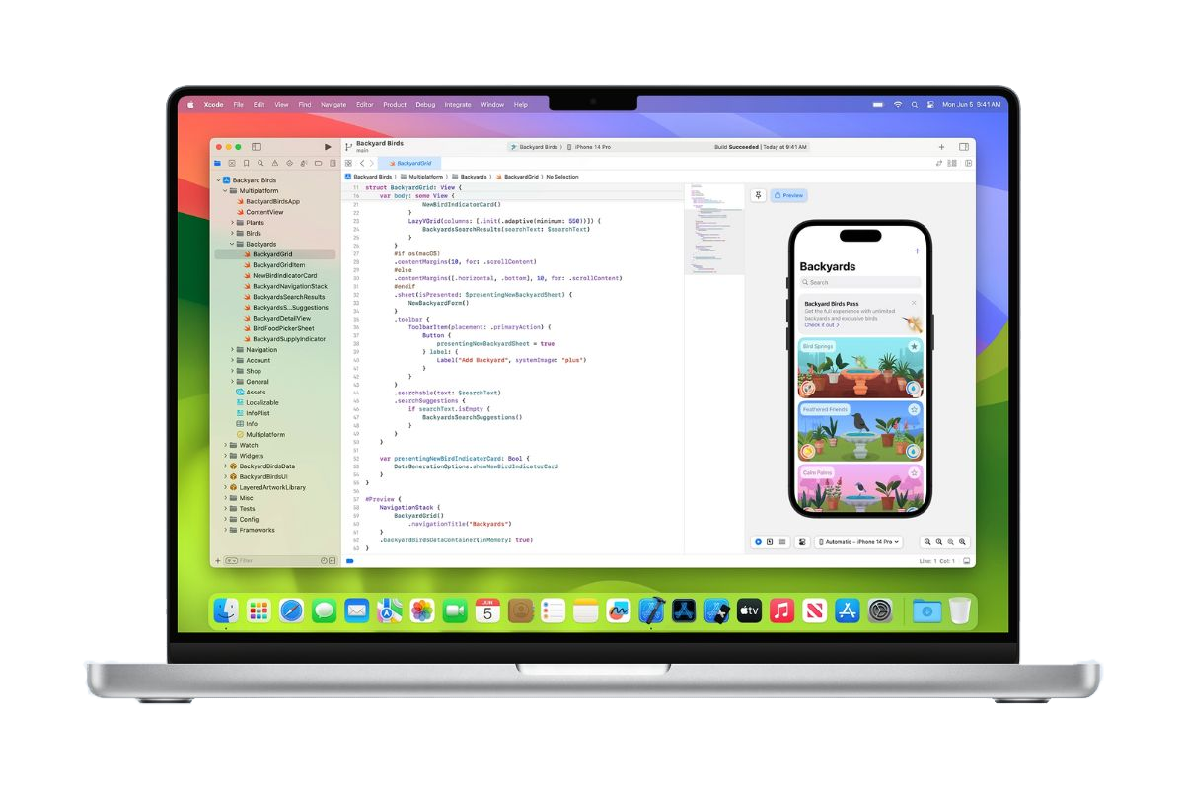
iOS Software Development Kits (SDK)
iOS SDK is a set of software tools, libraries, and resources provided by Apple for developing applications that run on iOS devices, including iPhones, iPads, and iPod Touch.
Xcode SDKs
The official integrated development environment (IDE) for macOS and iOS app development
Download
https://developer.apple.com/xcode/

Slide 5
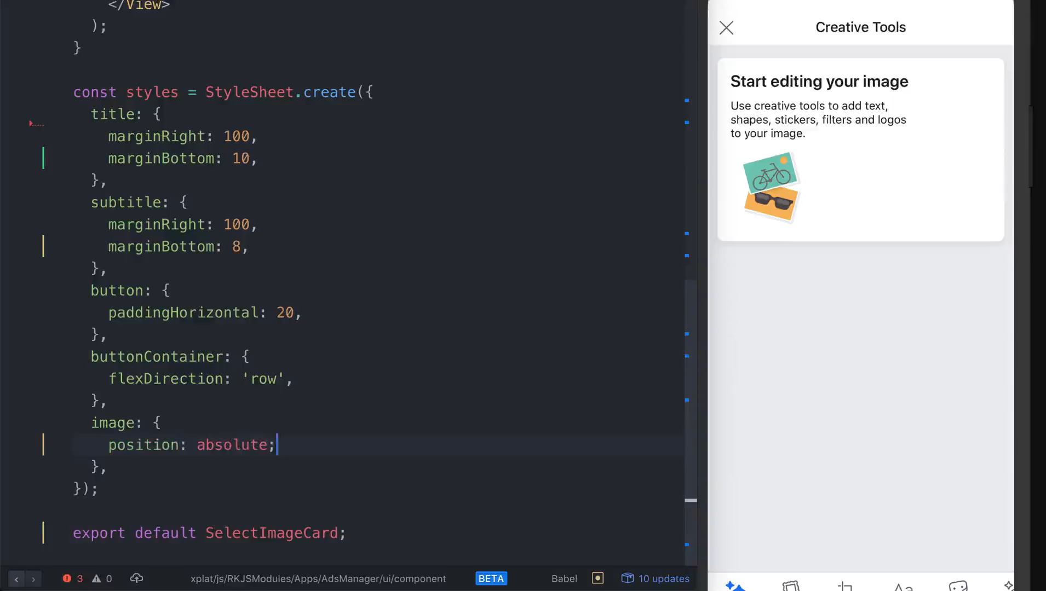
Cross-platform SDK
User-friendly but need additional tools, i.e., editor, emulator, etc
React Native Cross-platform SDKs
It is an open-source JavaScript framework for building mobile applications that can run on multiple platforms, including iOS and Android.
Written in JavaScript—rendered with native code
Fast Refresh

Slide 6
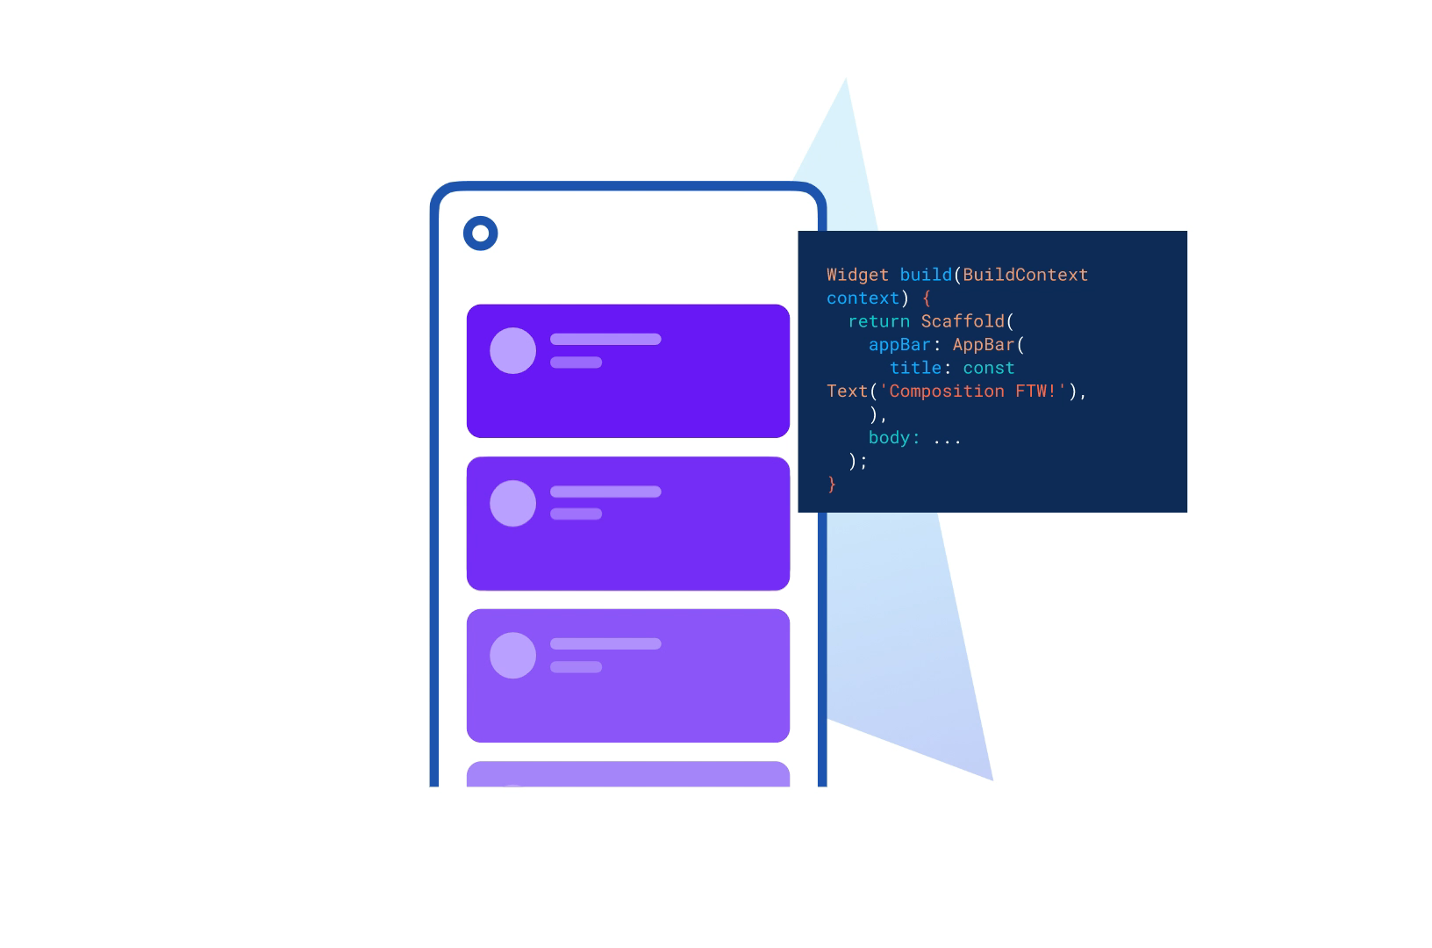
Cross-platform SDK
User-friendly but need additional tools, i.e., editor, emulator, etc
Flutter Cross-platform SDKs
It is an open-source UI software development toolkit created by Google.
Written in dart program language
Fast Execution
Modern language features

Slide 7
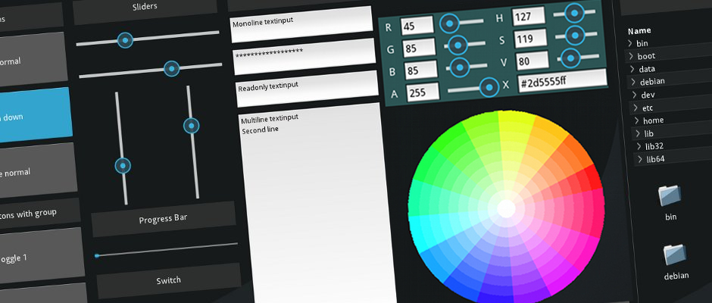
Cross-platform SDK
Kivy
An open-source Python library and framework for developing cross-platform mobile applications, including Android, iOS, Windows, Linux, and macOS.
Mostly used for GUI both desktop and mobile Apps

Slide 8
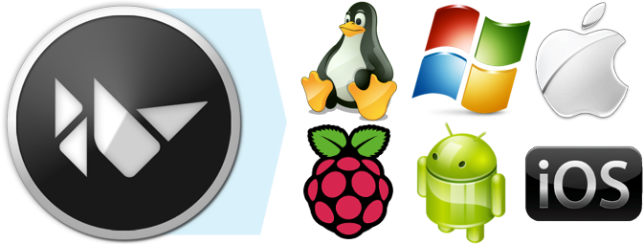
Understanding the Cross-platform SDK: Kivy
Widely used for desktop and/or mobile application
Work with Kivy is flexible, it can be run on:
Desktop computers: macOS, Linux, *BSD Unix, Windows.
iOS devices: iPad, iPhone.
Android devices: tablets, phones.
Any other touch-enabled professional/homebrew devices supporting TUIO (Tangible User Interface Objects).
Kivy empowers you with the freedom to write your code once and have it run as-is on different platforms.
The mobile apps made by Kivy need to be deploy into the device.

Slide 9

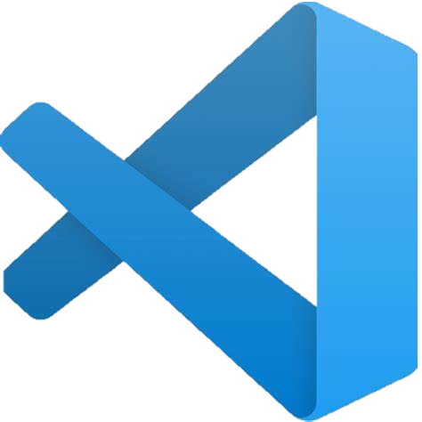
Understanding the Cross-platform SDK: Kivy
Installing Kivy
Note, Python and pip needs to be pre-installed
Using pip
pip install kivy
For detail, go to https://kivy.org/doc/stable/gettingstarted/installation.html
Work with editor

Slide 10
Understanding the Cross-platform SDK: Kivy
Refreshment
How well you know python?
What data initializes Coordinate object
class Coordinate(object):
def __init__(self, x, y):
self.x = x
self.y = y
Special methods to create an instance __ is double underscore
Parameter to refer to an instance of the class
Two data attribute for every coordinates object

Slide 11
Home Assignment (HW) - 02
Make a report on Kivy as an open-source python framework for cross plat-form development SDK.
Min 2 pages A4-paper, font TNR, 11, line space 1.5.
The report should contain:
History
The developer
Features
Implementation (what/whose company use it)

